Slide 1
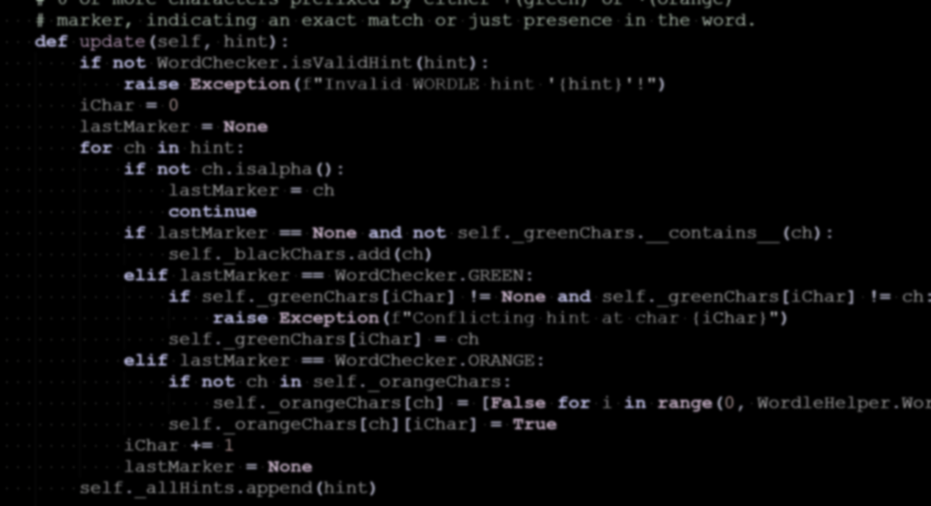


Veniți să cunoașteți echipa Code Sinaia 2024
13 iulie 2024
Copyright © by INPROTED – International Professionals for Technology and Education

Slide 2

International Professionals for Technology and Education INPROTED
Mission: connecting students with experienced engineers in software, technology and educators from renowned universities. Implementing projects for technology and education, training the engineers of the future.
Founders: Mihai Ene-Pietrosanu, Florin Teodorescu
STEM Projects (STEM acronym=Science Technology Engineering Math)
501(c)3 non-profit organization, registered in Oregon
http://inproted.org
Subscribe to InProTEd YouTube channel
Follow @inproted on Facebook
Summer Schools
Professional Development
Students Sharing Experiences
Advanced Programming for High School Students:
Online: Code Sinaia 2020-2021
In person: Code Sinaia 2022, 2023
Summer 2024: 5th edition!
“Career Matters for Women” webinar series
Two continents, One Story – Oct’21
Multiple paths for a CS graduate – Nov’21
Think challenge, think organic,
think future – Nov’21
presenters from Microsoft, Facebook, Intel
Technology presentations for students
“Computer Science and Engineering in the Netherlands” – Sep’21
“AI for good” – Dec’21

Slide 3







Code Sinaia - Unique STEM project for High School students
Enables high schoolers to explore computer science industry
Collaboration, teamwork, networking, diverse teams
Real-world projects in networking, games, webdev, OOP
Recognition for volunteering (useful for college admissions)
Organizing Team
Seasoned Engineers from multinational software companies (Microsoft, Intel, Facebook)
Teaching Assistants with international projects experience
Professors from University “Politehnica” of Bucharest

Slide 4
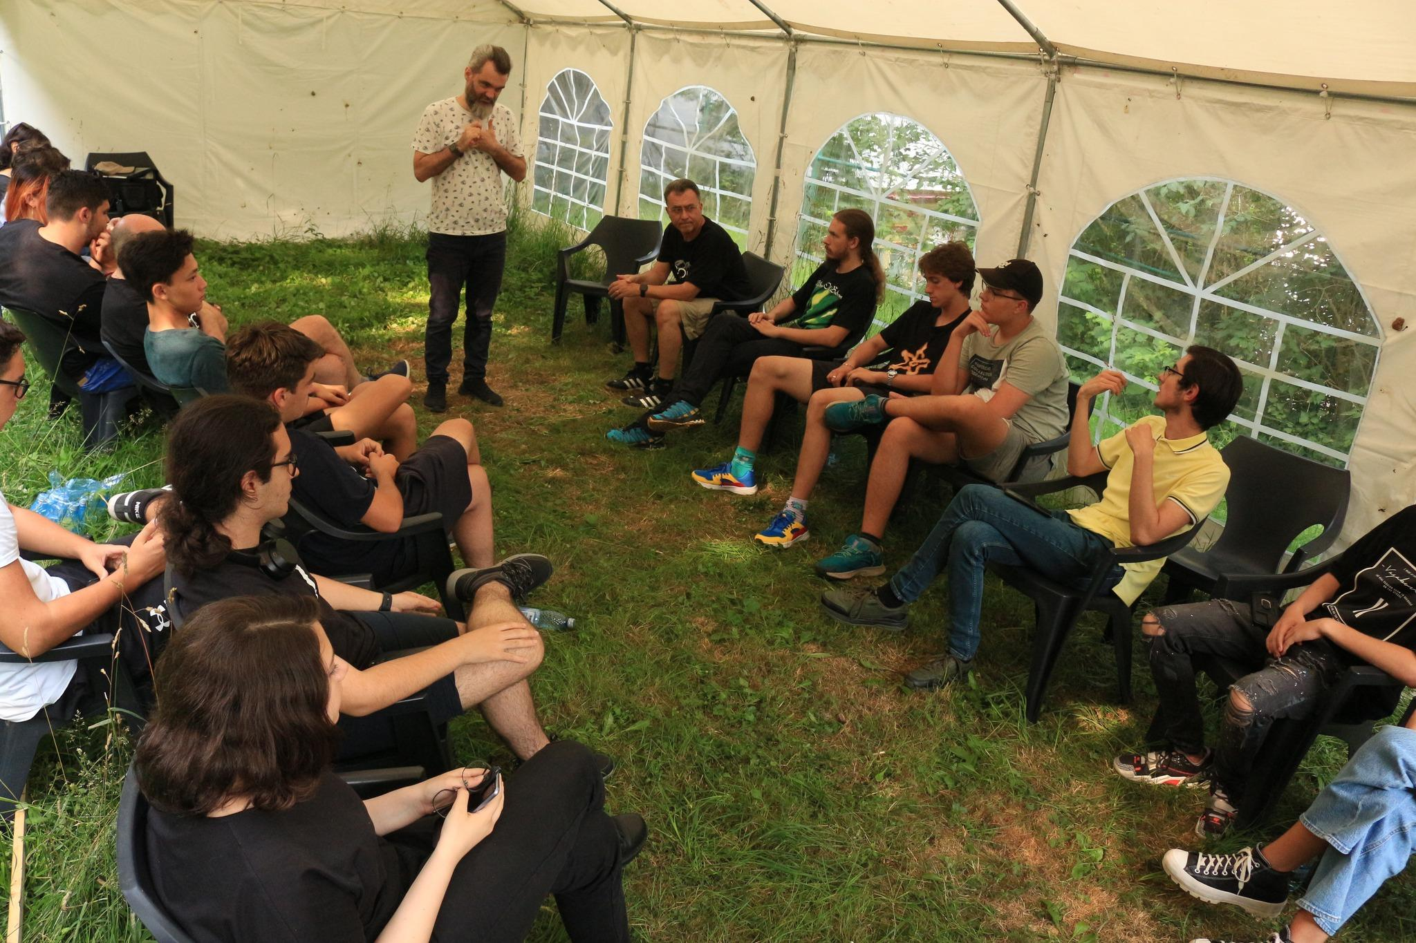
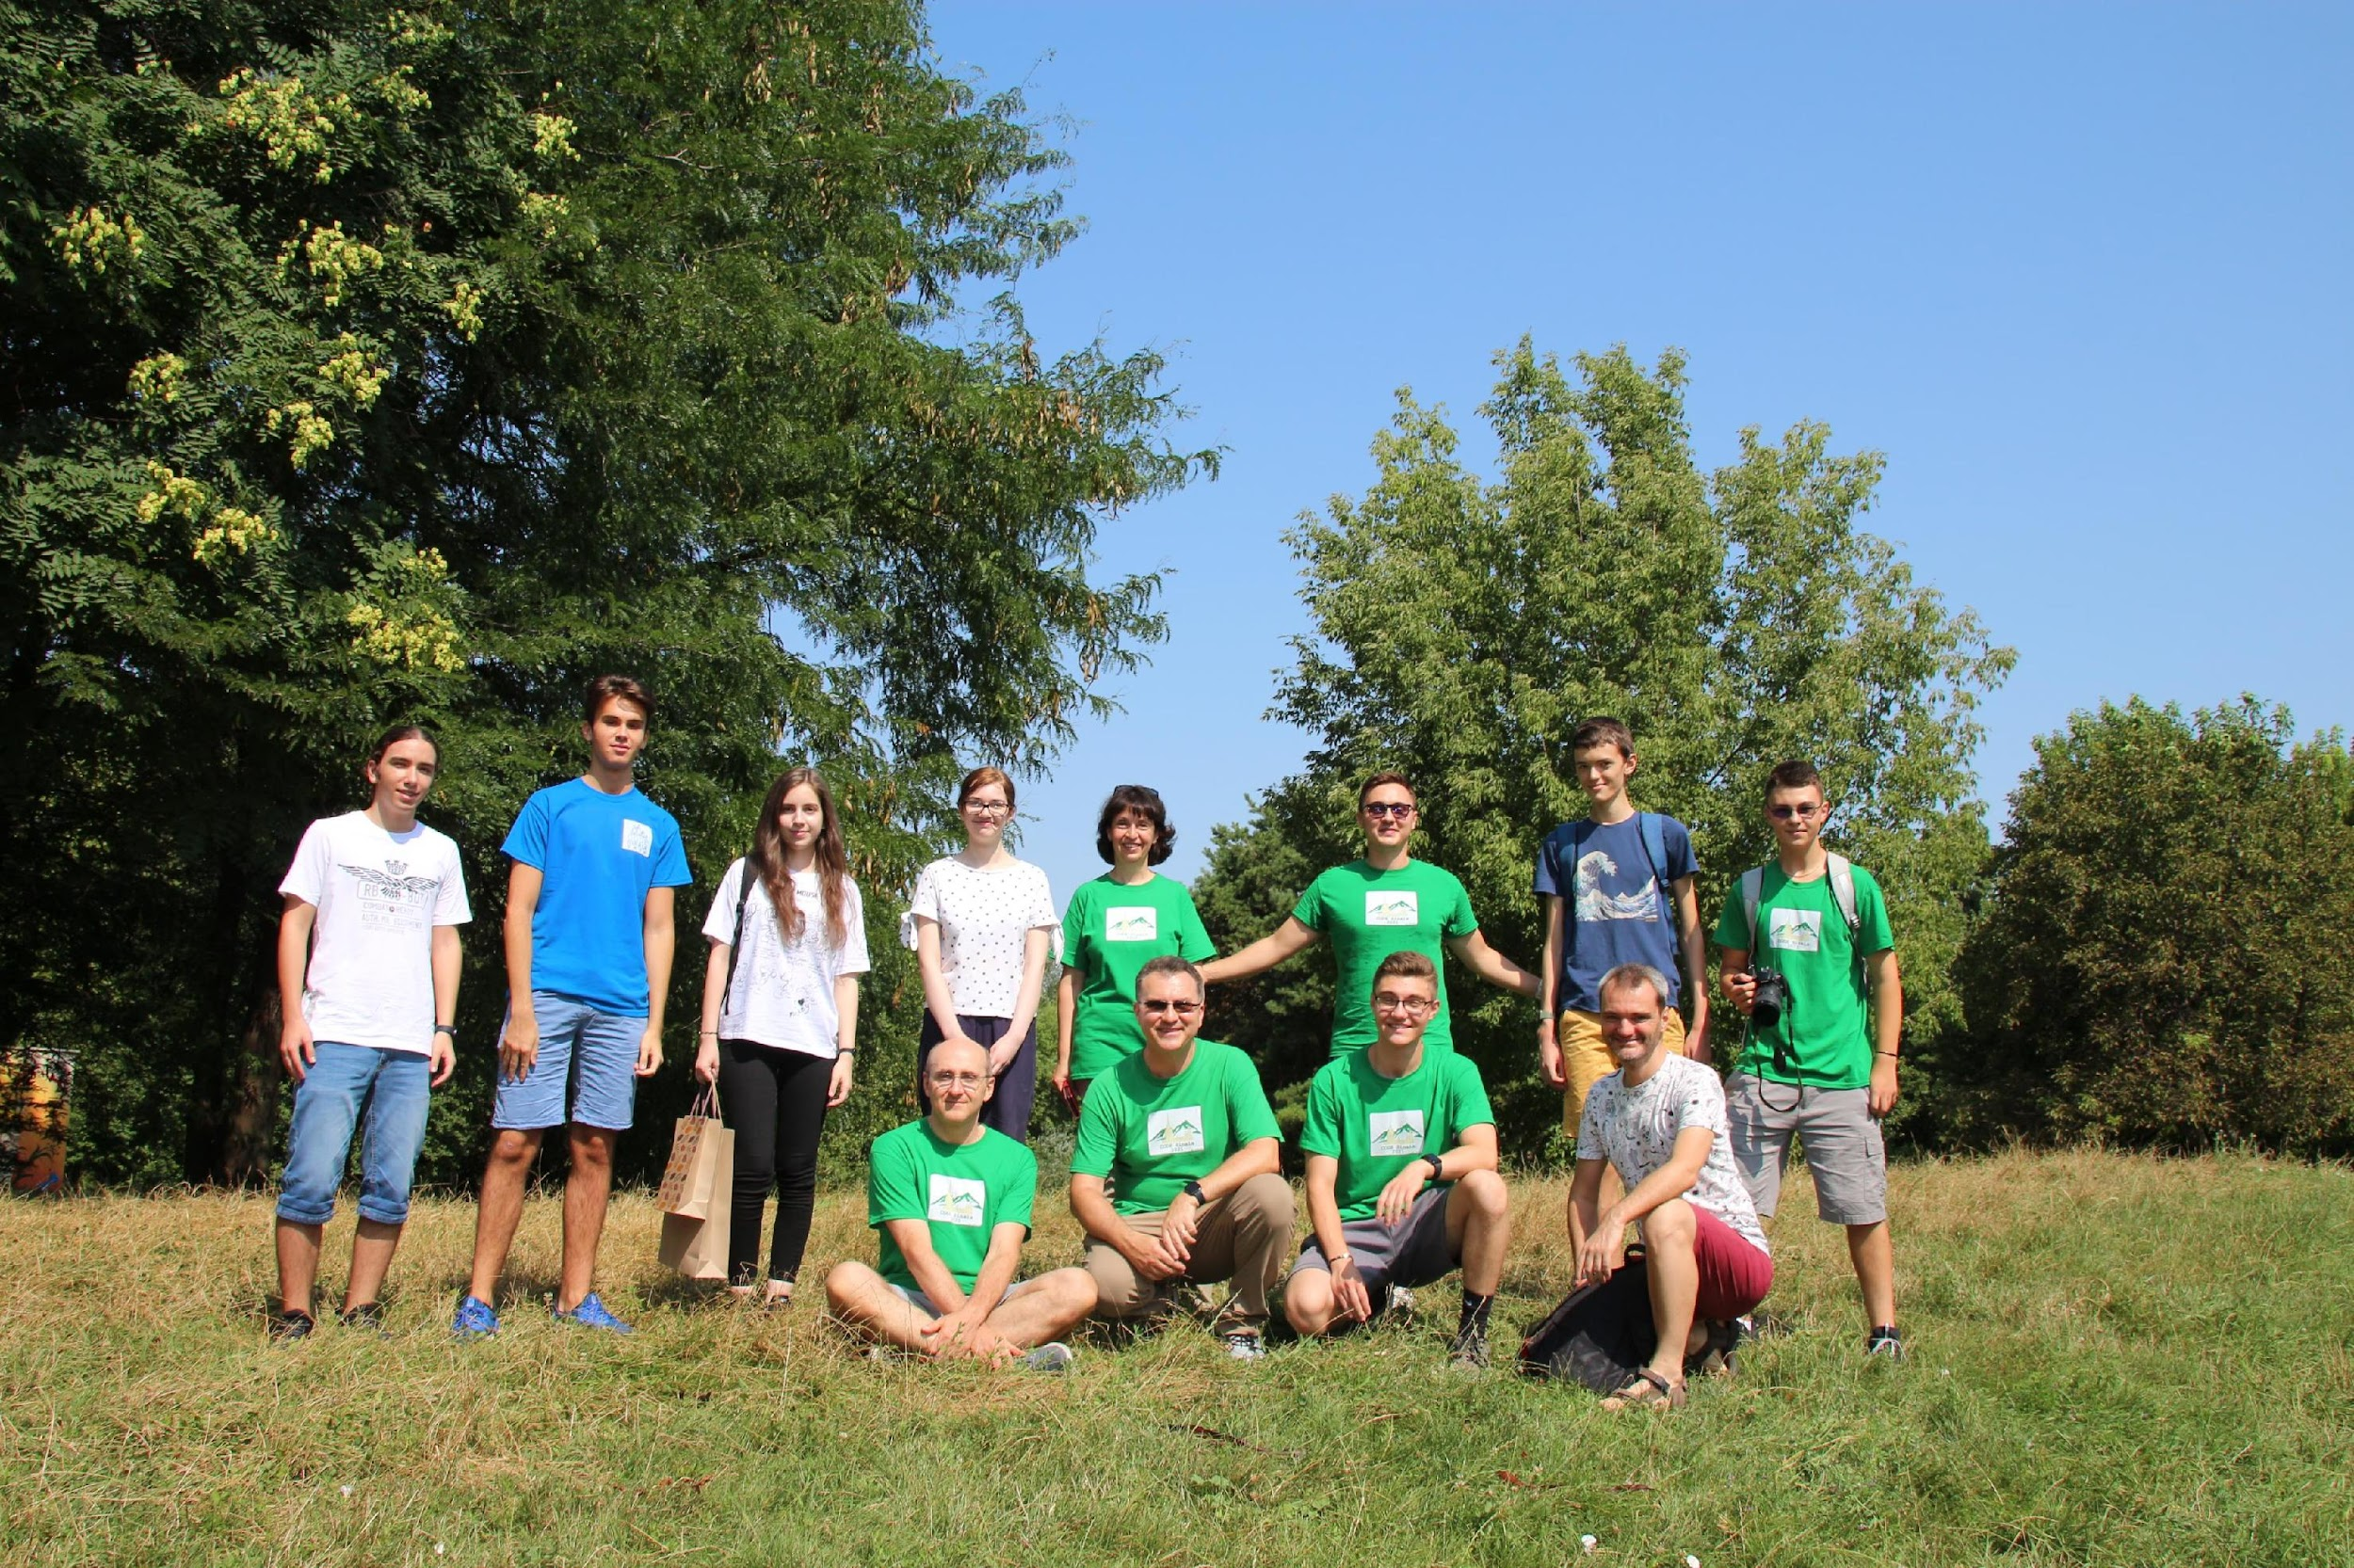
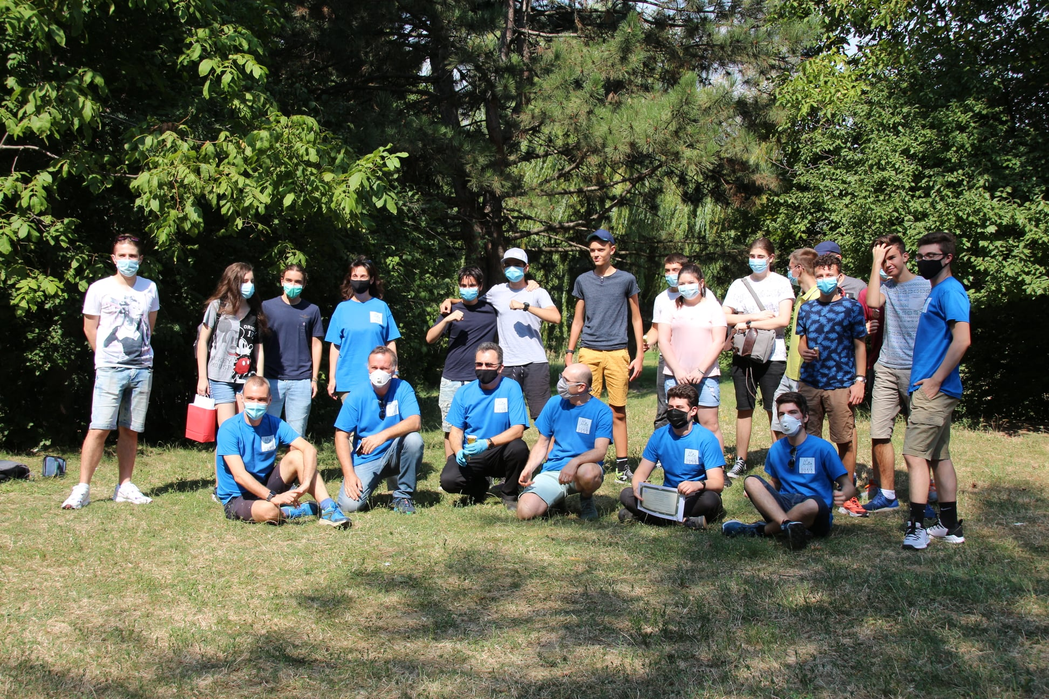
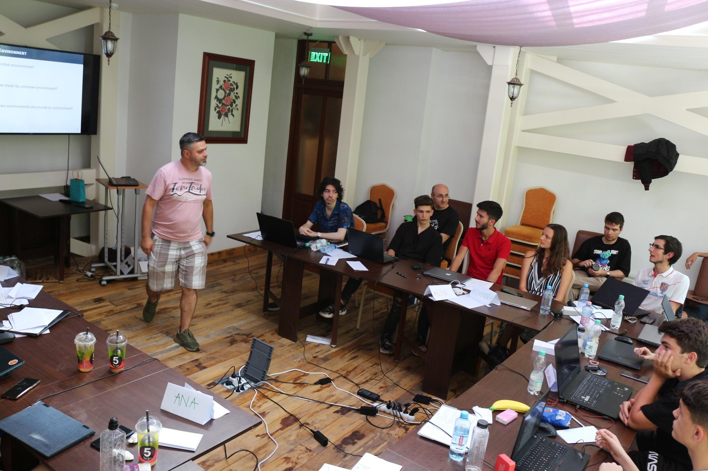
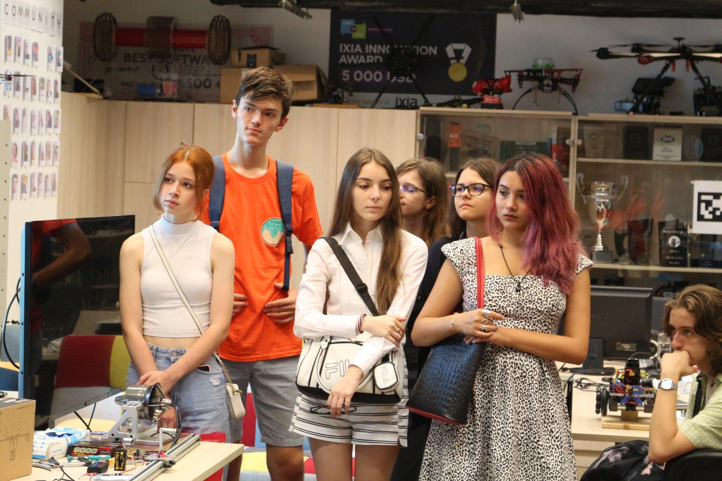
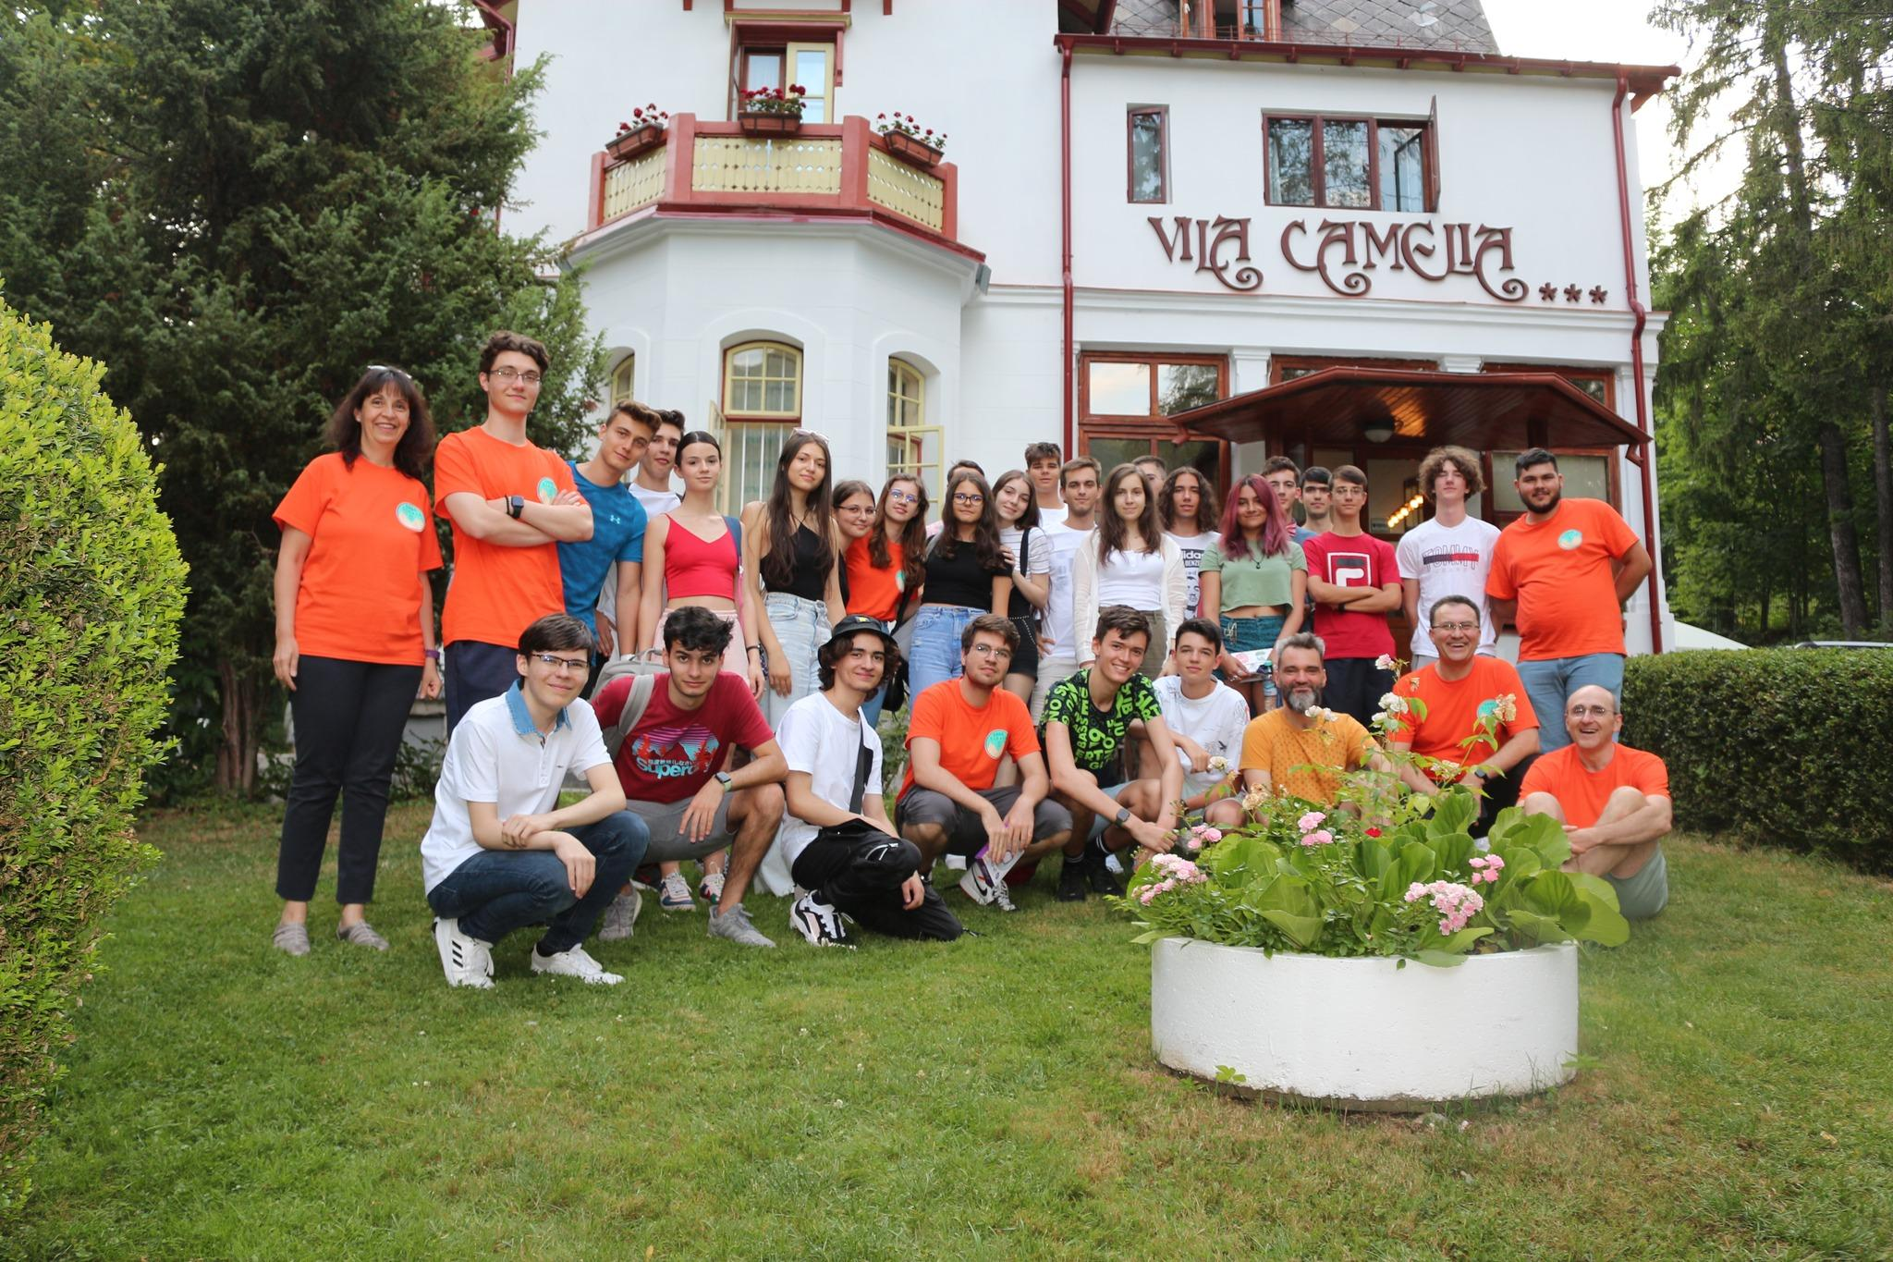
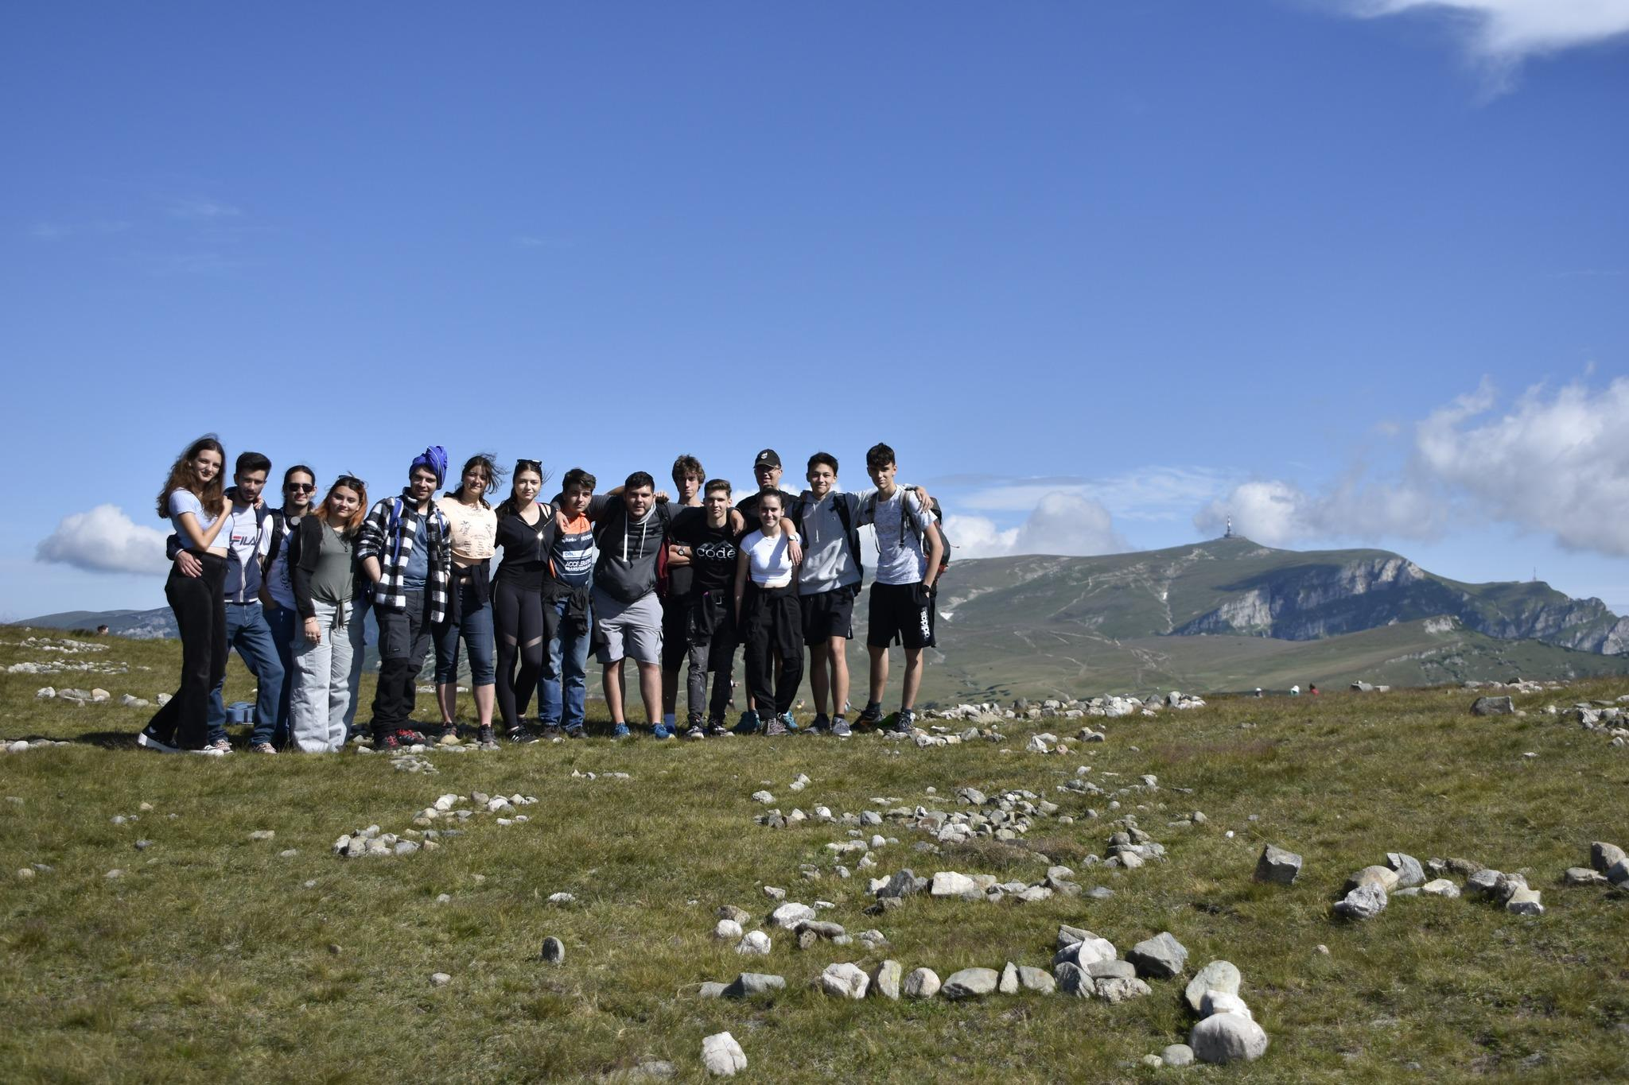
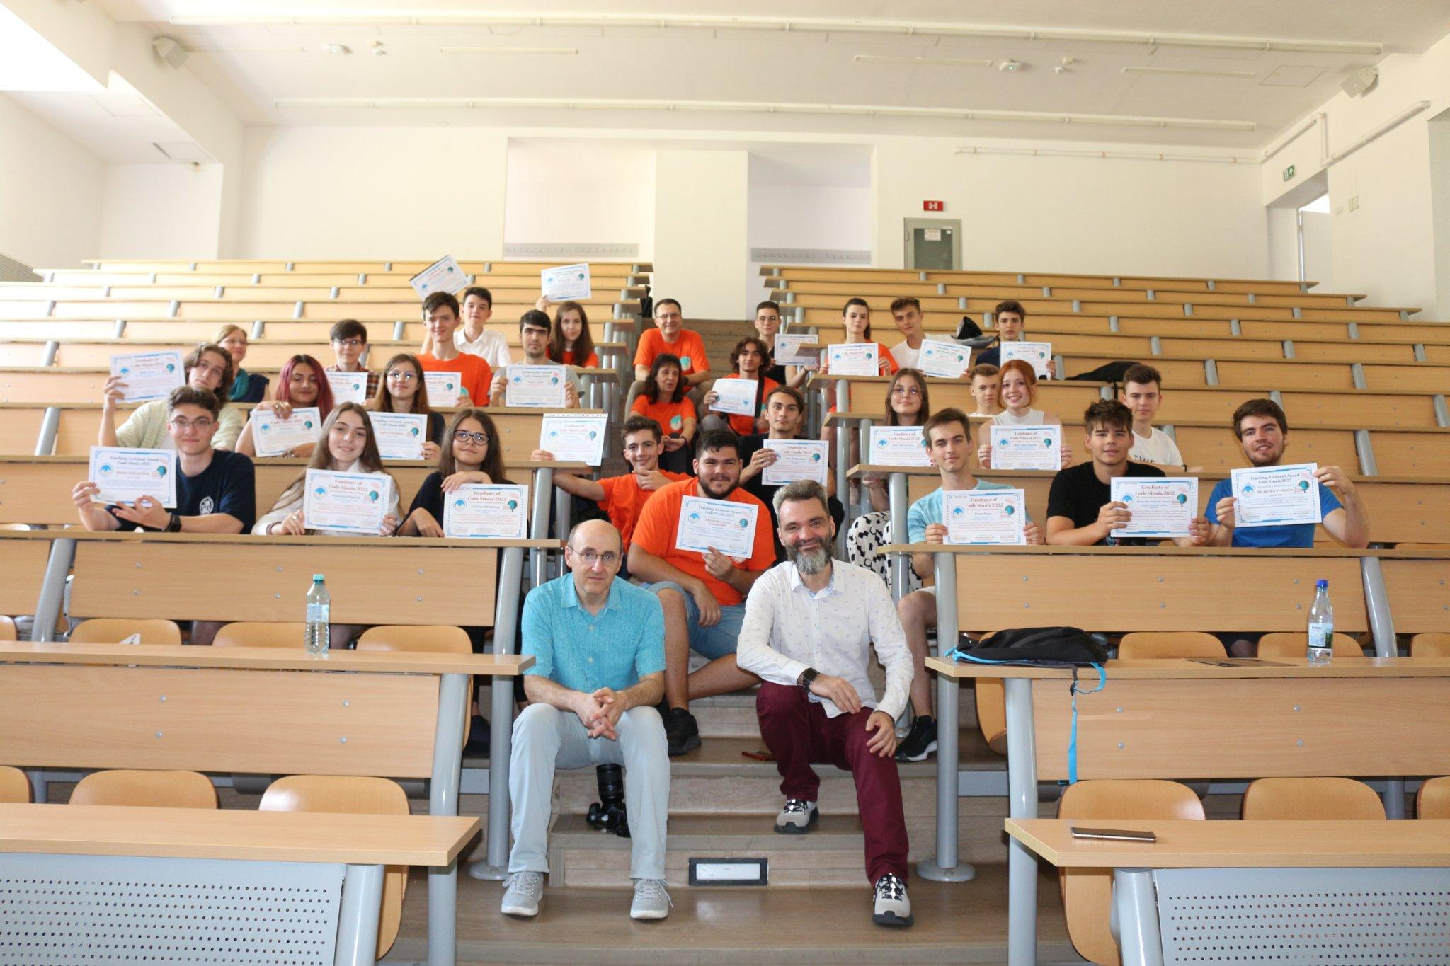
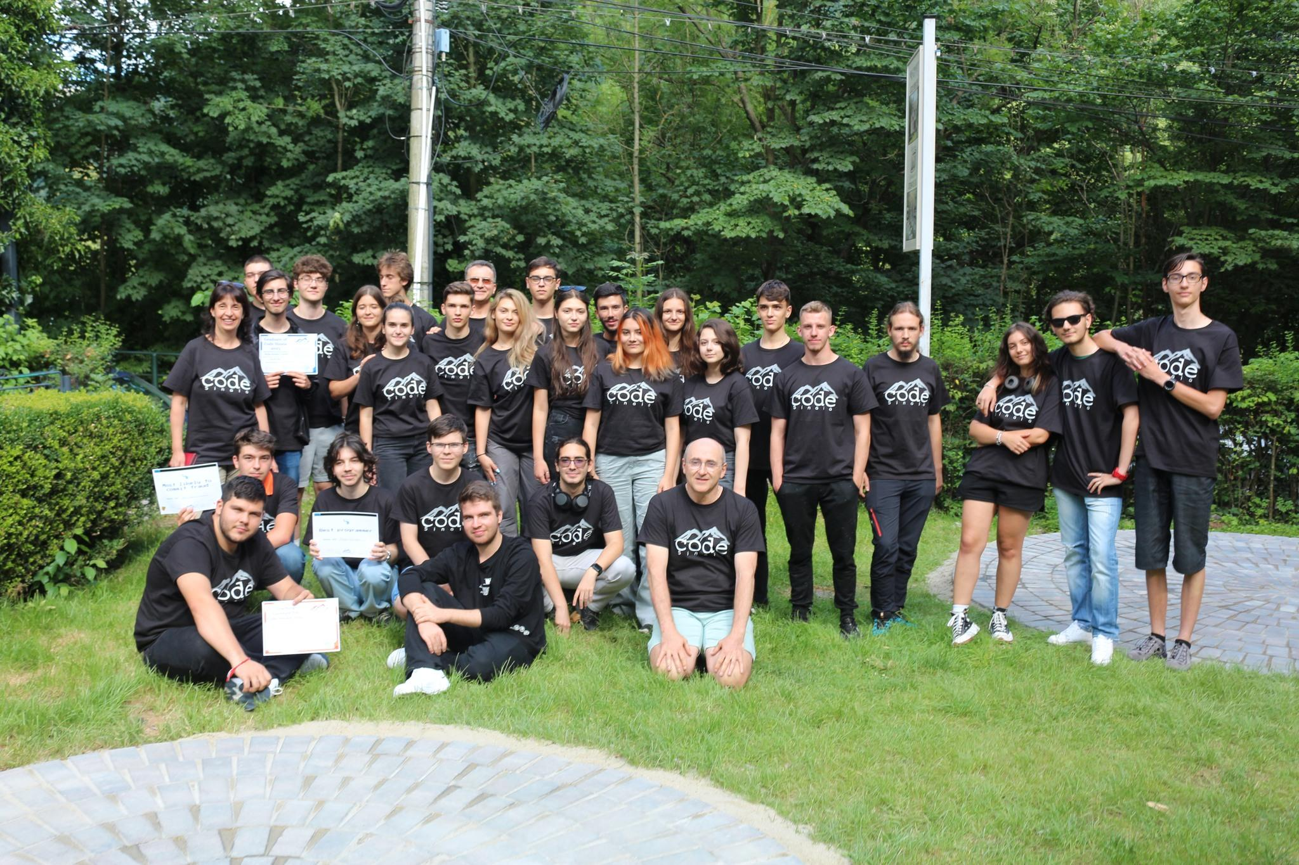
2024: doubling in size
50 participants,
10+ high schools, 6 cities
TAs from UK, USA, Netherlands, Romania
Started in 2020
Workshops with industry experts (Microsoft, Intel, Facebook) and university professors
22 participants
7 high schools, 3 cities
5 TAs from 3 continents
First 2 years online, awards ceremony in person
Visiting the new IoT and Networking labs University Politehnica of Bucharest
One week courses and labs in Sinaia
Final day: hike in Bucegi Mountains

Slide 5
Echipa Code Sinaia 2024

Slide 6
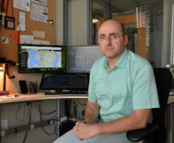
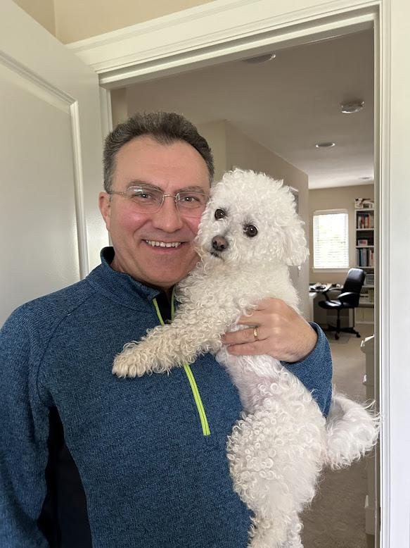
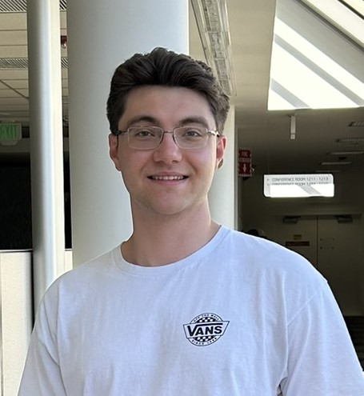
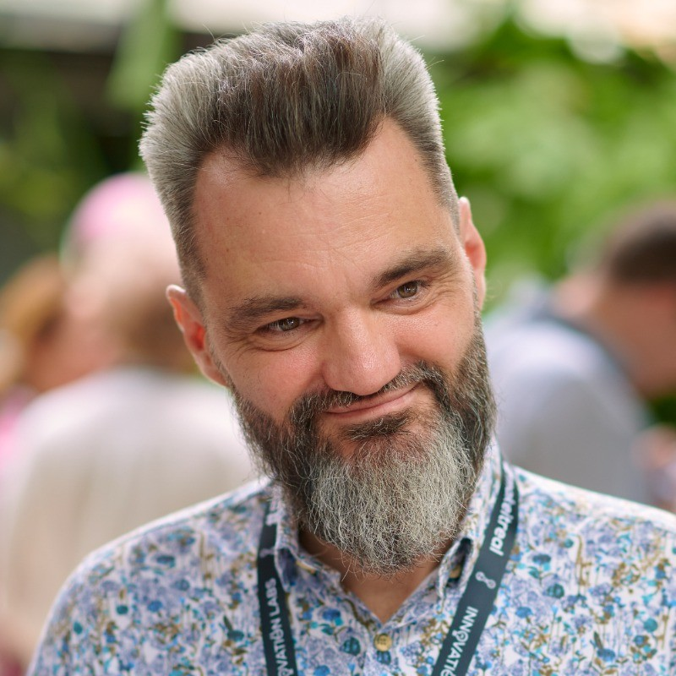
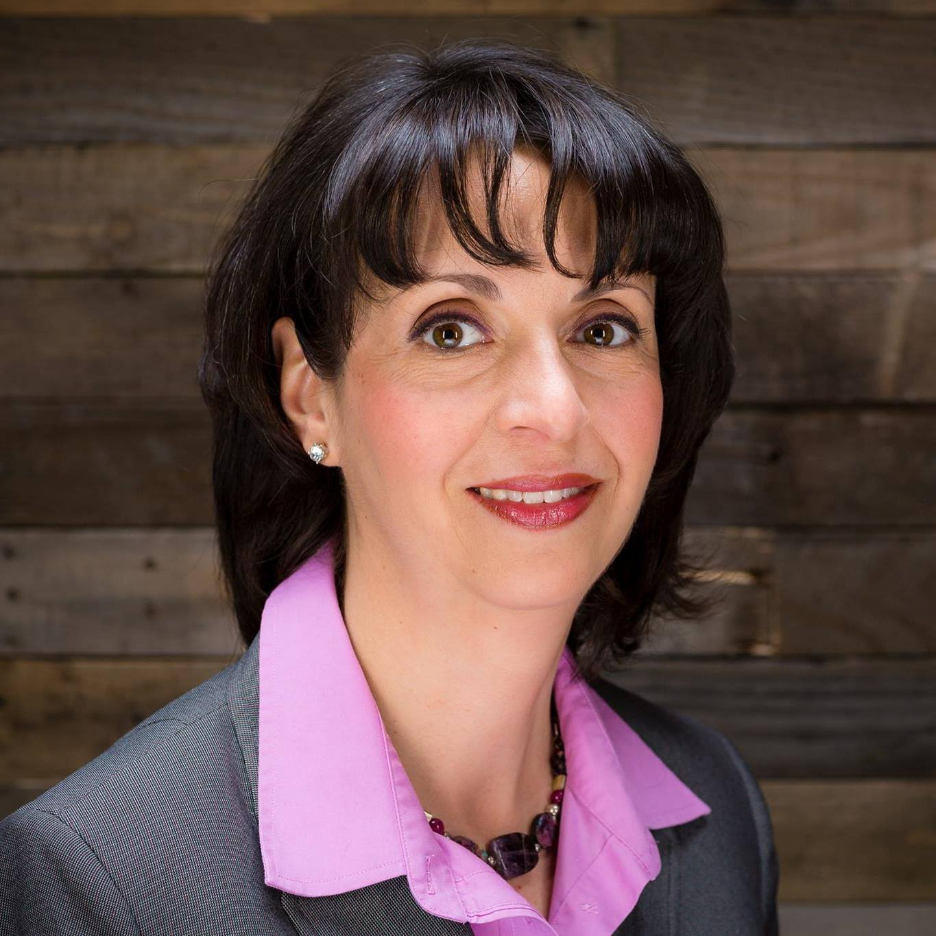
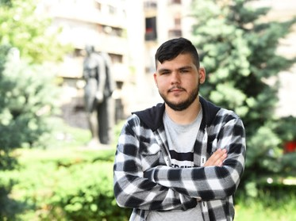
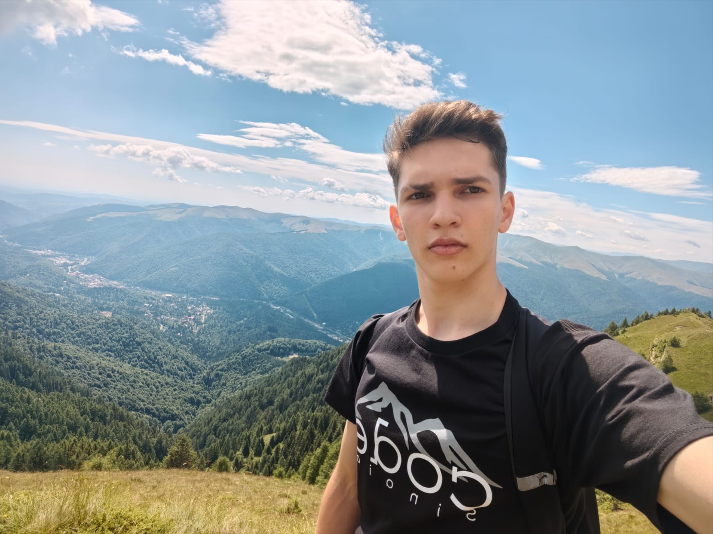
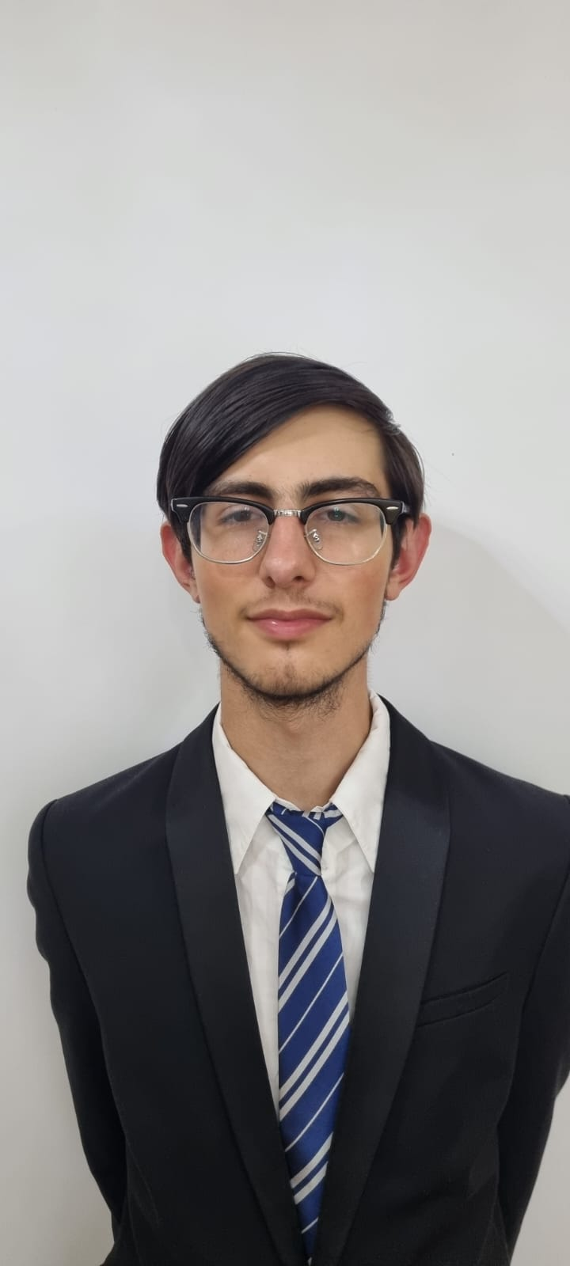
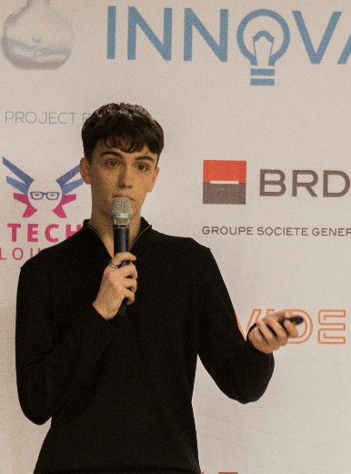
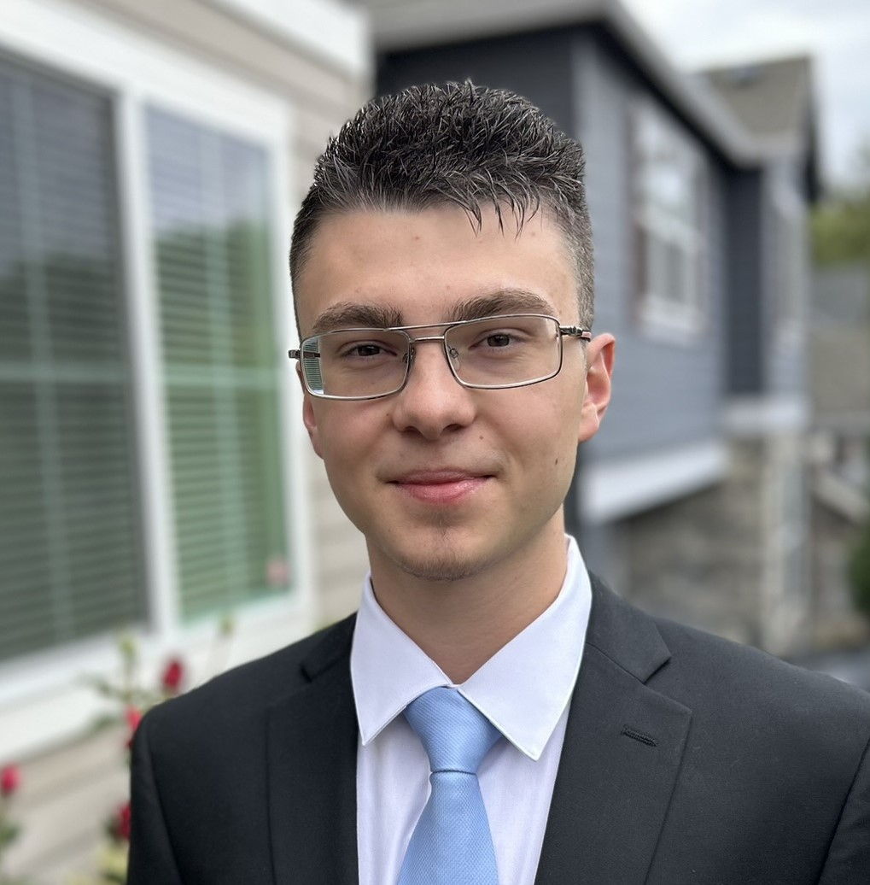
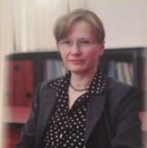
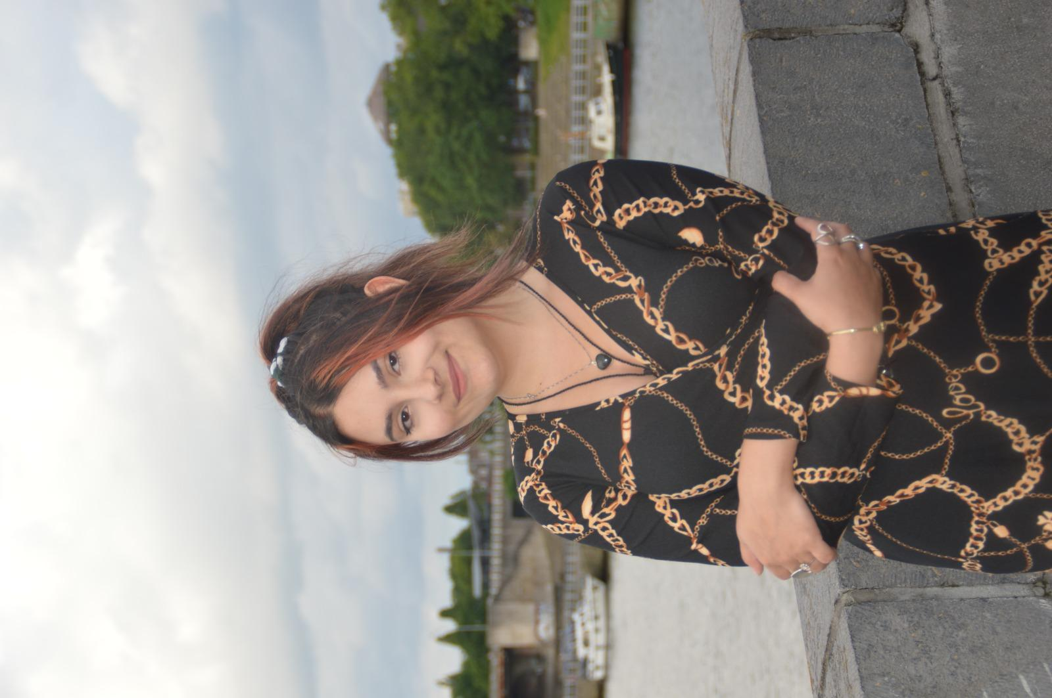
Echipa Code Sinaia 2024
Ing. Florin Teodorescu, co-fondator INPROTED, Principal Software Development Lead, Microsoft, Seattle, SUA
Ing. Mihai Ene-Pietrosanu, Program Manager, co-fondator INPROTED, SUA
Stefan Ene, student si Teaching Assistant, Oregon State University
Prof. Dr. Ing. dr. Razvan Rughinis, Universitatea Politehnica București, co-fondator Innovations Labs
Dr. Ing. Monica Ene-Pietrosanu, Director of Software Engineering, Intel
Prof. Gabriela Corobana, Colegiul National “Mihai Viteazul”
TA: Alexandru Constantin, Ioana Nistor, Alin Ene, Andrei Virlan, Remus Rughinis

Slide 7
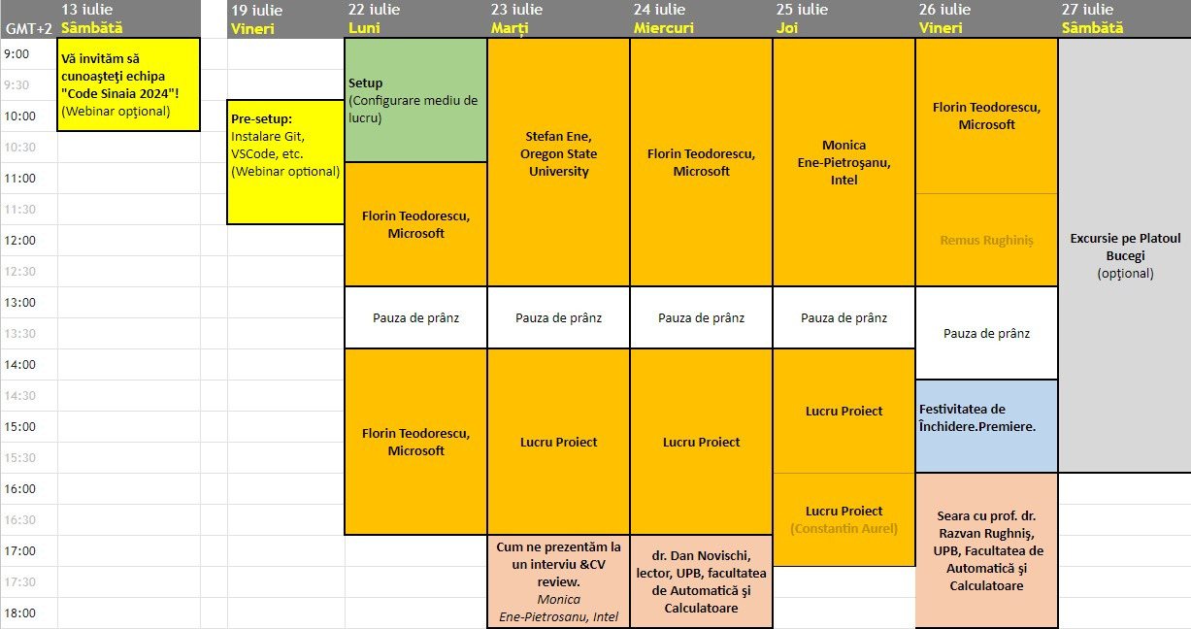
Program Code Sinaia 2024

Slide 8


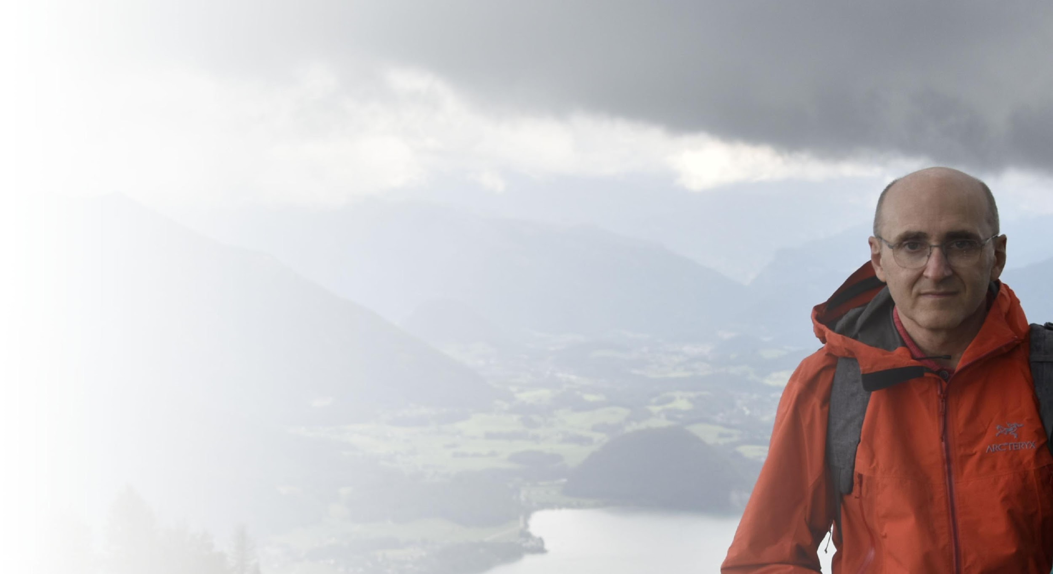











Florin Teodorescu
Format la Liceul Tudor Vianu (Informatică - 1987) și Automatică și Calculatoare UPB (1993).
Master în Programare Distribuită la ENSIMAG, INPG, Grenoble, Franța (1994).
Fost asistent la Automatică și Calculatoare UPB (1993-1997).
Sisteme de Operare Avansate, Programare Distribuită, Limbaje Formale și Compilatoare.
Principal Software Engineer la Microsoft din 1998 - Bellevue, Statele Unite:
Windows Networking, Virtual Earth, Windows Phone, Bing, Maps & Geospatial.
Profesor (voluntar) de Computer Science, Lake Washington School District din 2014.
Membru fondator InProTEd și Instructor la toate edițiile Code Sinaia.
Instructor de ski certificat PSIA L2
Instructor Mountaineers of Seattle în ski mountaineering și crevasse rescue.
Pasionat de alpinism, ski touring și fotografie.

Slide 9
Code Sinaia 2024
Explore Real World Software Projects
Shared source code, Application developed & automatically deployed to cloud
Data Structures, Algorithms |  | Software Engineering |  | Cloud/Web Development
Linked lists, Queues, Stacks, Trees, Graphs | Dijkstra, Spanning tree, AStar, Heapsort | Source Control Open Source fundamentals Teamwork, mentoring, DevOps, CI/CD Unit testing | GitHub Visual Studio Code Agile project management GitHub Actions | Client-Server Web Server Cloud Hosting Security | JavaScript, HTML/CSS Node.JS Azure

Slide 10
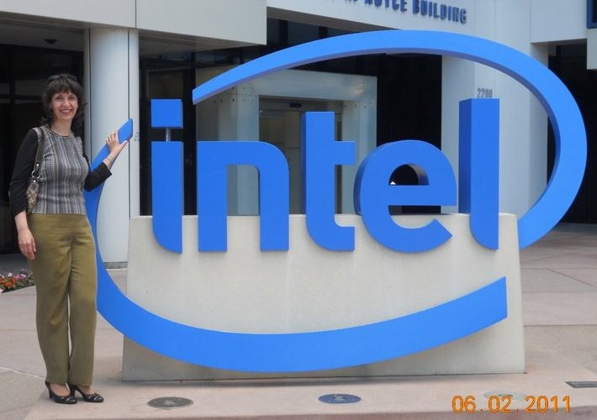
Monica Ene-Pietroșanu
Vom învăța împreună despre:
Tranziții în carieră: Cum sa ne prezentăm la un interviu. CV review
Bazele securității informatice
Inginerie … “cu capul în nori”
MSc/BSc Calculatoare (UPB) + Matematica (UB)
Doctorat ȋn Calculatoare (UPB), 5 brevete de invenție (SUA)
13 ani la Microsoft + 13 ani la Intel, ȋn US și Europa
A condus și dezvoltat două centre multinaționale:
Microsoft EMEA Global Technical Support Center
Intel Romania Software Development Center"
Notes:
cinci brevete de invenție în SUA legate de tehnologii de securitate și criptare

Slide 11


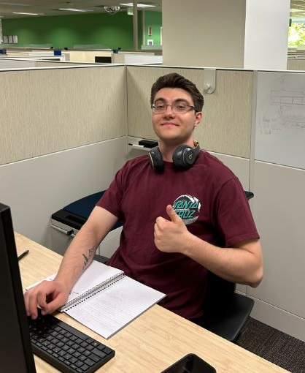


Stefan Ene
Student la Oregon State University, Honors BSc in Computer Science Systems, Minor in Mathematics
TA la Code Sinaia incepand din 2020
Internship la Intel in vara 2024
Full-time undergrad researcher in vara 2023
Internship la Keysight Technologies in vara 2022
Instructor la Code Ninjas pe durata liceului

Slide 12

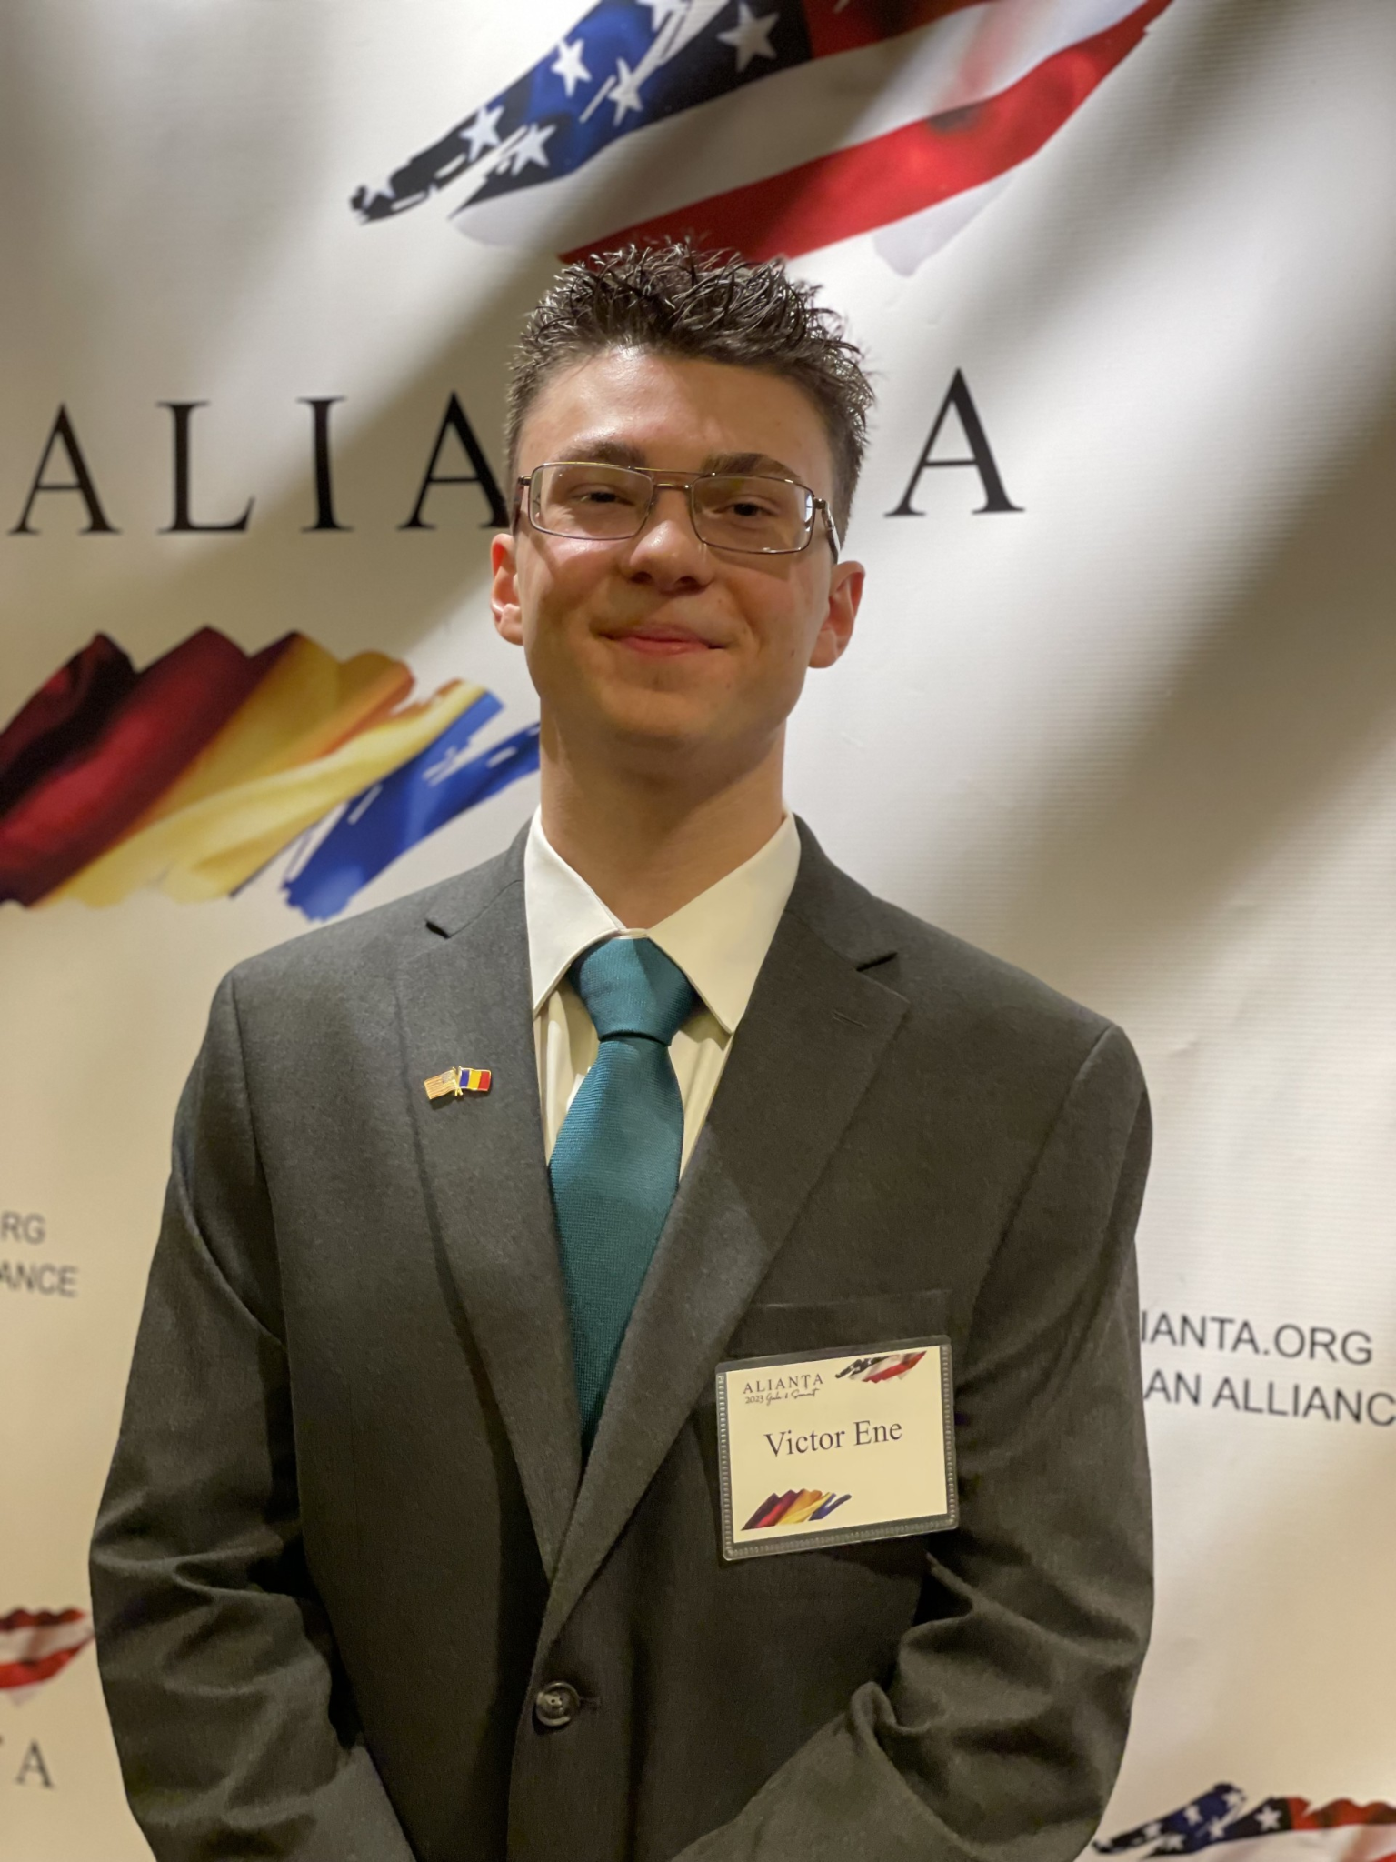

Victor-Ionuţ Ene
5th year taking photos, posting stories and designing digitally/graphically
Rising freshman at Purdue University majoring in Aeronautics and Astronautics Engineering
In my free time, I play basketball, photograph, draw/sketch
I’m the guy that will take care of you before/during/after each school day
Currently intern at the National Institute for Aerospace Research “Elie Carafoli” in Bucharest

Slide 13
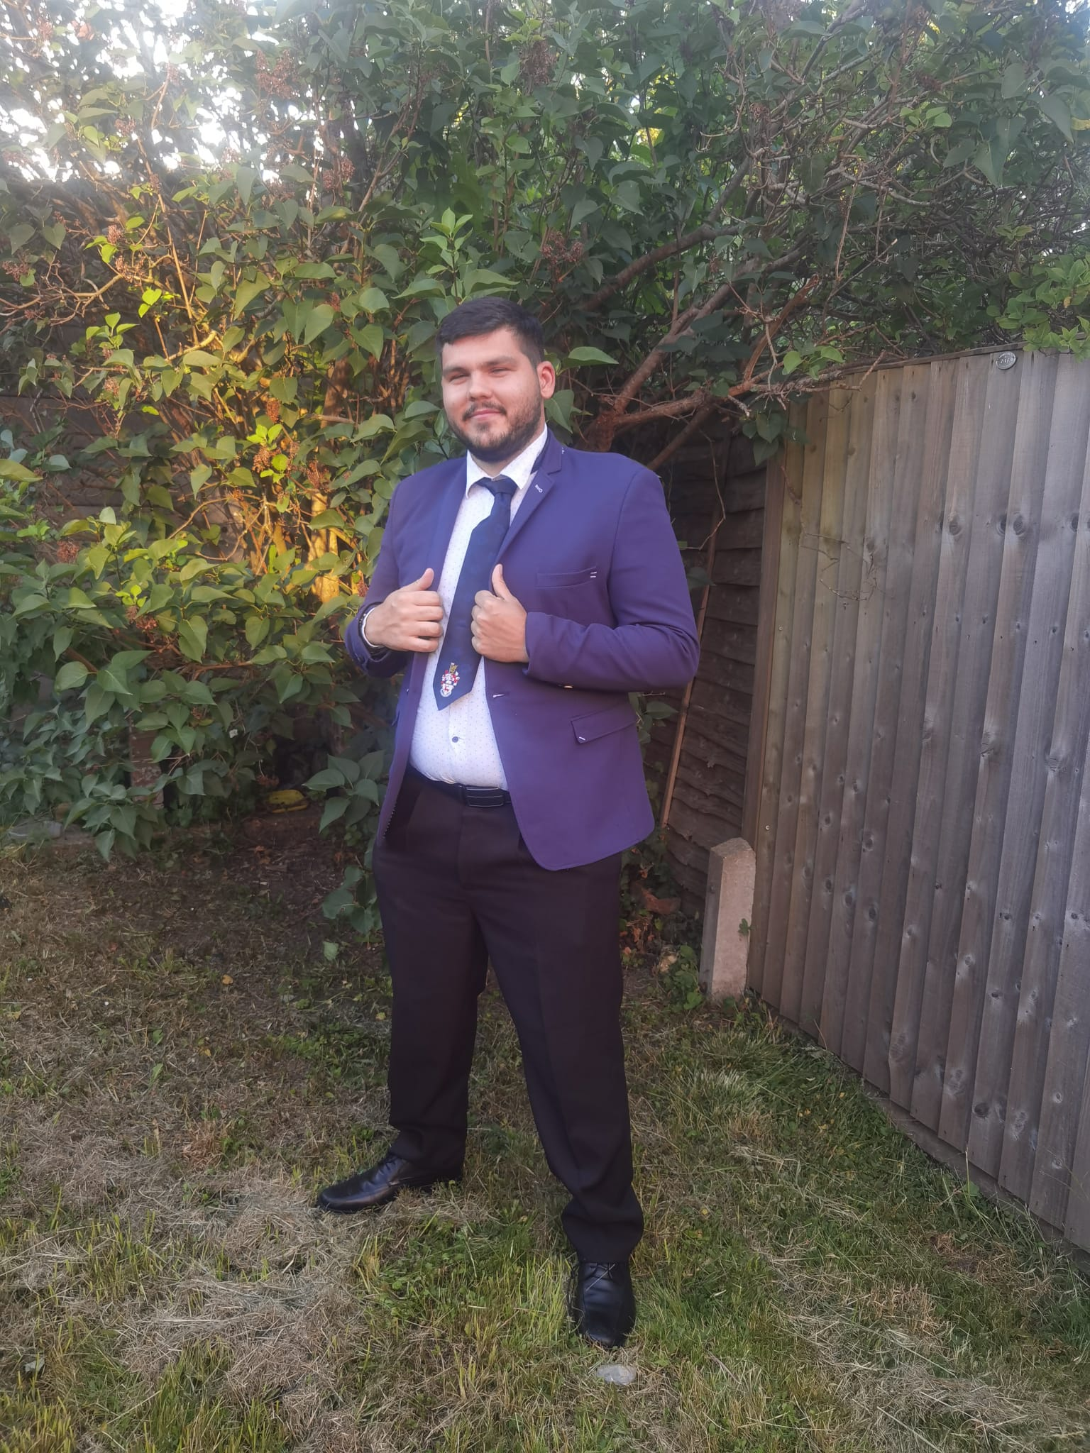
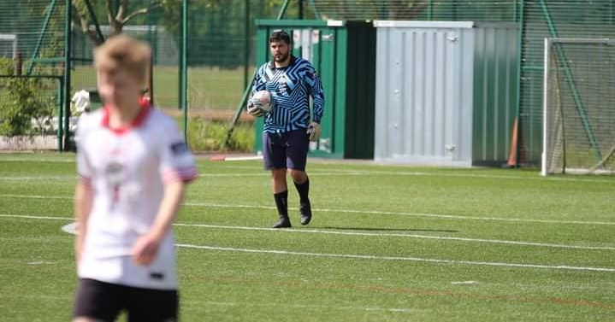
Alexandru Constantin
Student la University of Southampton – Facultatea de Inginerie și Științe Exacte (FEPS) – Computer Science with Cyber Security - Anul 4
Președintele Romanian Society Southampton
Căpitanul Archers Road FC 2 - Echipă de Ligă Intramurală
Participant la toate edițiile Code Sinaia
TA din ediția Nr. 2 - 2021

Slide 14
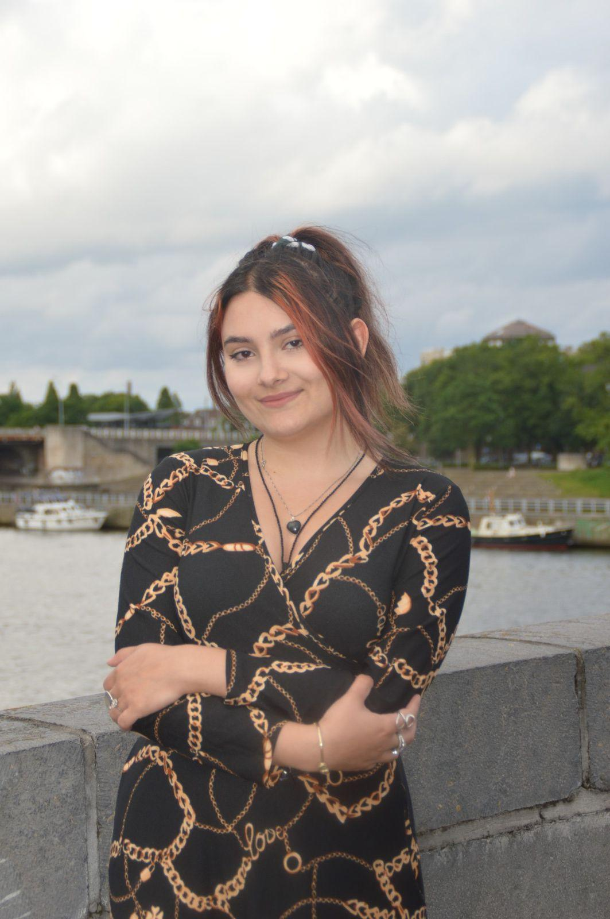
Ioana Raluca Nistor
Studenta la Maastricht Science Programme, University of Maastricht;
Specializare în programare și neurostiinta;
Experienta in C/C++, Python, Java;

Slide 15
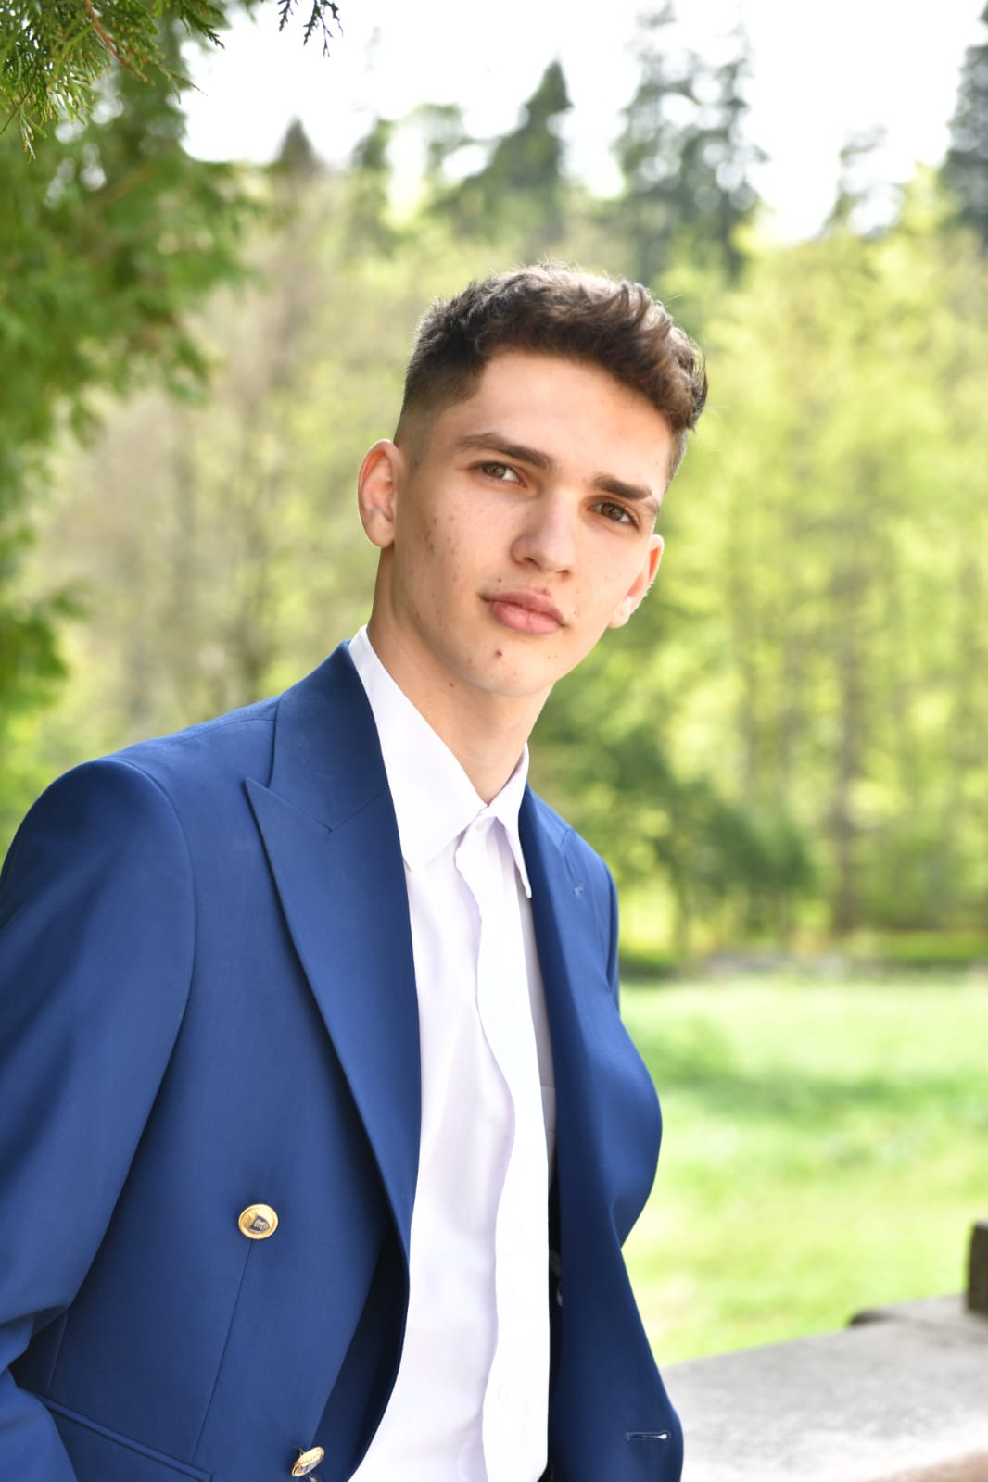
Ene Alin
Absolvit Colegiul “Mihail Cantacuzino” Sinaia
Participant Code Sinaia din 2021, ambasador pentru
Code Sinaia 2022, 2023, 2024, TA 2024

Slide 16
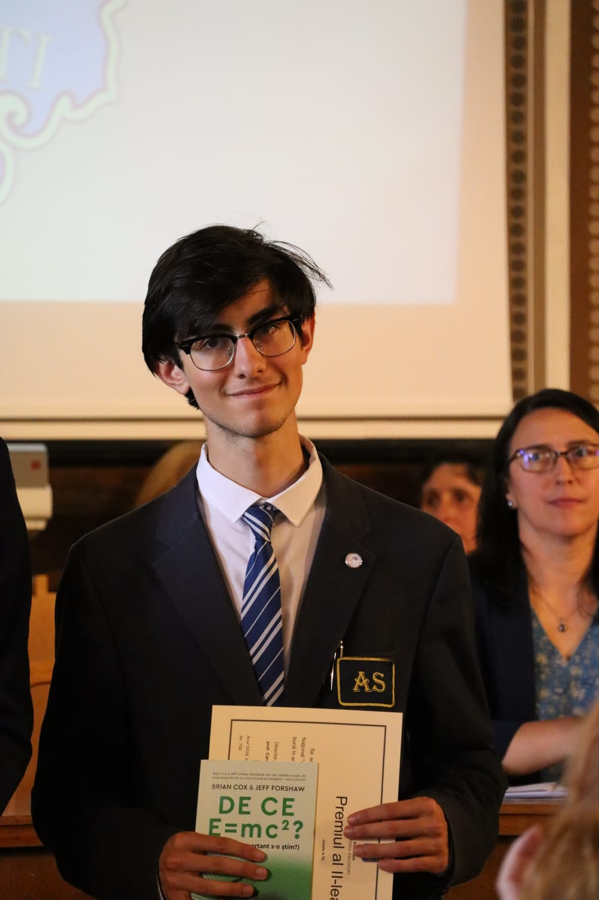
Andrei Virlan
Elev la Colegiul National “Andrei Saguna” Brasov, profil mate-info
Participant Code Sinaia 2023
Pasionat de fizica

Slide 17
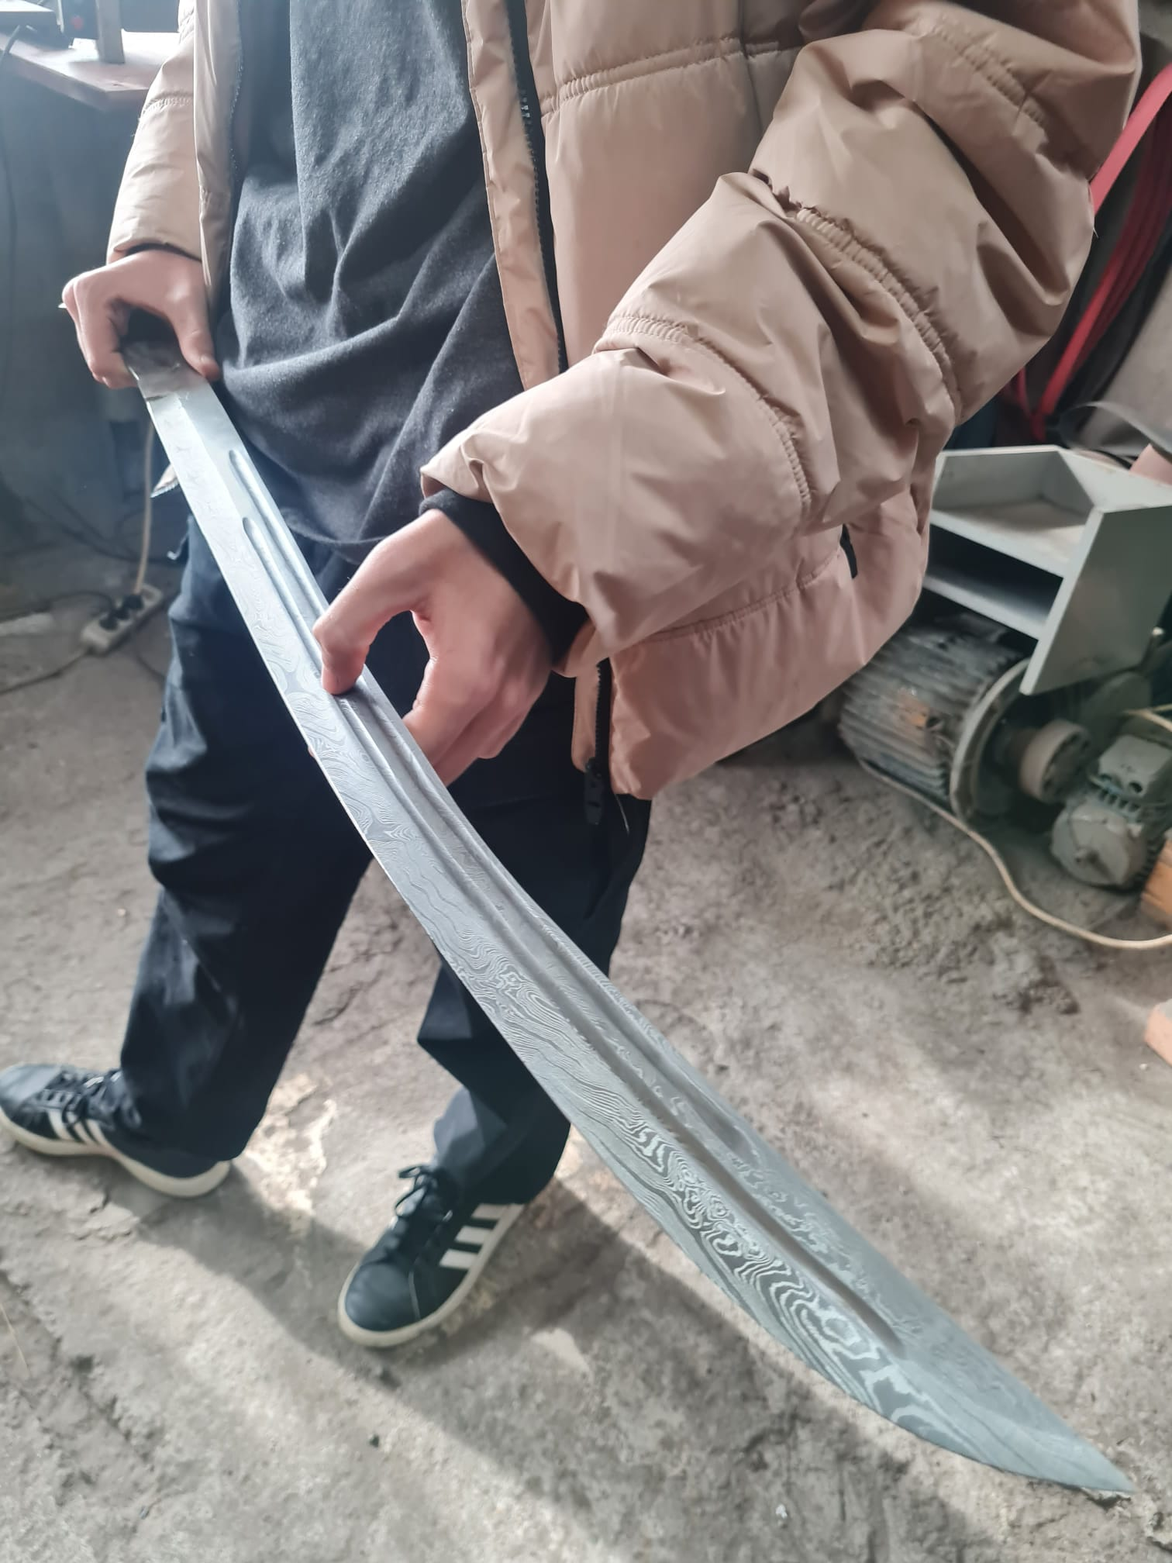








Remus Rughiniș
Internships / Jobs:
Participant @ Code Sinaia 2023
Student @ Laude-Reut E.C. (Bucharest)
Co-founder at Pentest Copilot, winner of Innovation Labs 2024 startup accelerator
Biology enthusiast (internship at University of Basel in June 2024)
History nerd (spent internship money buying a sword)

Slide 18
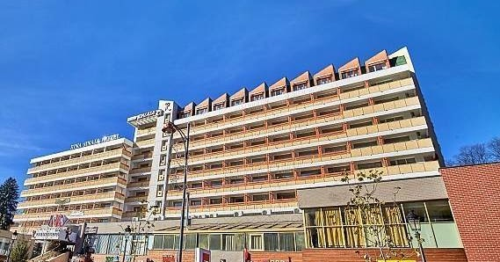
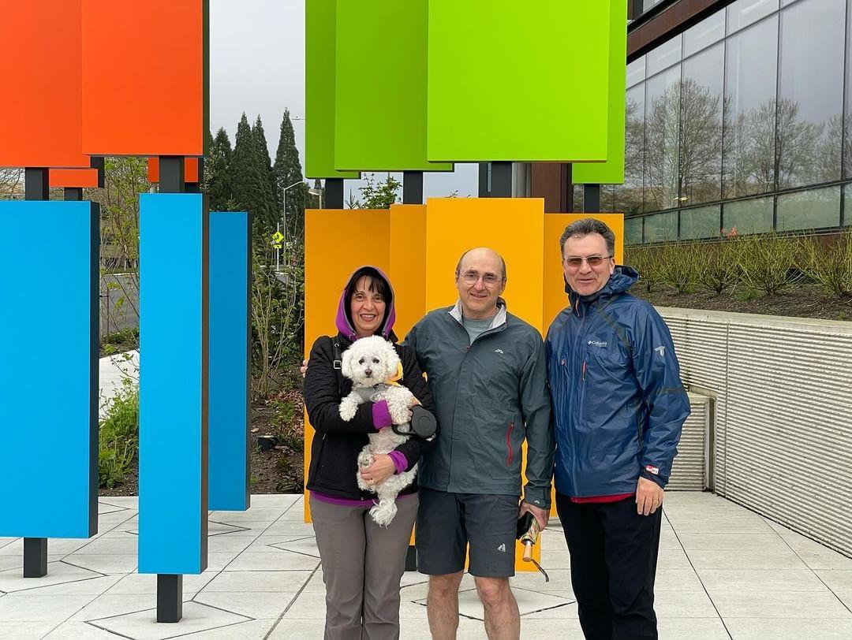
Vă aşteptăm la Code Sinaia 2024
22-26 iulie, Rina Hotel Sinaia
Sesiuni de lucru dimineața și după-amiaza,
Prezentări cu invitați din industrie și universitate
Îmbunătățire CV. Tehnici de interviu.
Teamwork: Învățăm și programăm împreună
Relații, socializare
http://inproted.org
Subscribe to INPROTED YouTube channel
Follow @inproted on Facebook

Slide 19


Q&A
De la elevi: …?
De la parinti: <>

